Slide 1
The Content of An Abstract
BRUSSELS, BELGIUM | 1986 | AIDS in Africa
NAPLES, ITALY | 1987 | Science in challenging AIDS
ARUSHA, TANZANIA | 1988 | AIDS and associated cancers in Africa
MARSEILLE, FRANCE | 1989 | Epidemiology of AIDS in Africa
KINSHASA, DR CONGO | 1990 | Struggle against AIDS in Africa
ABIDJAN, COTE D’IVOIRE | 1997 | AIDS and Development
DAKAR, SENEGAL | 1991
YAOUNDE, CAMEROON | 1992 | Clean and safe blood for all
MARRAKEH, MOROCCO | 1993 | Africa Unity against AIDS and STDs
KAMPALA, UGANDA | 1995 | Challenges and Hopes
LUSAKA, ZAMBIA | 1999 | Looking into the future: Setting priorities for HIV/AIDS
OUAGDOUGOU, BURKINA FASO | 2001 | The communities commit themselves
NAIROBI, KENYA | 2003 | Access to care: challenges
ABUJA, NIGERIA | 2005 | HIV/AIDS and Family
DAKAR, SENEGAL | 2008 | Africa’s response: Face the facts
ADDIS-ABABA, ETHIOPIA | 2011 | Own, Scale-up and Sustain
CAPE TOWN, SOUTH AFRICA | 2013 | Now More Than Ever, Targeting Zero
HARARE, ZIMBABWE | 2015 | AIDS in Post 2015 Era: Linking Leadership, Science & Human Rights
ABIDJAN, COTE D’IVOIRE | 2017 | Africa: ending AIDS-delivering differently
KIGALI, RWANDA | 2019 | AIDS FREE AFRICA - Innovation, Community, and Political Leadership
DURBAN, SOUTH AFRICA | 2021 | Africa’s AIDS response: The race to 2030 – Evidence. Scale Up. Accelerate
HARARE, ZIMBABWE | 2023 | AIDS IS NOT OVER: Address inequalities, accelerate inclusion and innovation
Morenike Oluwatoyin Ukpong
Obafemi Awolowo University
Ile-Ife, Nigeria

Slide 2
Outline
Target audience for the session
Introduction
Definition of research and its dos and don’ts
Content of an abstract
What to do when drafting the abstract
Why abstracts are important
Common flaws with abstract writing
Conclusion

Slide 3
ICASA Call for Abstract Submission is Out
Conference scheduled for Dec.
Taking place in Ghana
Excellent array of sessions
Members benefit from mentorship
The society is launching a journal

Slide 4
Target audience for this presentation
Researchers who conduct primary studies:
Quantitative research
Qualitative research to inform the design of the quantitative research
Qualitative research to explore the findings of the quantitative research
Researchers who conduct implementation research
Programmers who conduct monitoring and evaluation
Community advocates who implement community based programs

Slide 5
Introduction
An abstract usually acts as a summary of work already completed
Abstracts are usually developed after a research data analysis has been done
It is used by prospective readers to decide whether or not to listen to the full abstract presentation.
Are used to propose paper topics/panel sessions at professional conferences.

Slide 6
Definition of research
Research is “a systematic investigation, including research development, testing and evaluation, designed to develop or contribute to generalisable knowledge (FHI, 2000)”
Systematic: An organized, formally structured methodology to obtain new knowledge. It commonly implies the development of a research protocol with clearly stated objectives.
Generalisable: The obtained knowledge is intended to have a broad or general application beyond the group that participated in the research. The new knowledge will have applications beyond the study setting.

Slide 7
Do and don’t of all research
Obtain an ethics clearance before collecting data or when you plan to undertake secondary data analysis. No publication of data should be done without obtaining ethics clearance for the research.
01
Ensure confidential handling of data. Except otherwise, all research data should be presented anonymously.
02
Conduct research to address the unknown.
03
Share all research data. Conference abstract presentation is one way to do this. Please make the best use of this opportunity.
04

Slide 8
An abstract
An abstract summarizes the major aspects of a paper
Sequence:
The Purpose of the study and the research problem(s) investigated
The basic design of the study
Major findings or trends found as a result of your analysis
A brief summary of the author’s interpretations and conclusions.
Credit: USC Libraries Research Guide. Organizing Your Social Sciences Research Paper. Accessed from https://libguides.usc.edu/writingguide/abstract on April 5, 2021

Slide 9
Content of an abstract
Typically, an informative abstract answers these questions in 150-500 words:
Why did you do this study or project?
What did you do and how?
What did you find?
What do your findings mean?

Slide 10
Format of a research abstract
Background: What is the problem this work attempts to solve?
Aim: What does this work attempt to achieve?
Methodology: study design, population, location, period of data collection, outcome and explanatory variables and statistical methods used for analysis.
Results: Include specific data that indicates the results of the project.
Conclusion: The answer to the research question the implication of the work? How does this work add to the body of knowledge on the topic?

Slide 11
Abstract - Background
This should include two sentences.
The first sentence highlight the gap the study tries to address.
The second sentence highlights the study objective(s).

Slide 12
Objective(s)
Study objectives need to be SMART
Specificity means there is clarity about what needs to be done
Measureable means the right study design can be determined
Achievable means the variables can be measured
With an appropriate study design , study is Reliable
When the study is Time bound, the study can be finite

Slide 13
Abstract - Methods
Opens with a sentence on the study design, target population and study location.
Date of data was collected.
All the study variables.
Statistical analysis tool(s).
Ensure the details here are comprehensive.

Slide 14
Abstract - Results
Information on the sample size
Description of the variables
Outcomes of the inferential analysis
Include the details in figures except when the journal instructs you not too.
Ensure results answer study objectives

Slide 15
Abstract – Conclusion
Two statements required
The answers to the study objective(s).
The recommendation based on evidence derived from the study.

Slide 16
Study Title
It’s the last thing to write
Includes information on study design
Includes information on study variables
Includes information on study population or location
Comment on the study title
Make it attractive

Slide 17
When drafting an abstract
Look over your subject and question the significance of your ideas; emphasize the important results.
Ensure the results address the study objective(s). Also ensure the conclusion(s) are derivable from the study results.
Please note the abstract will be read without the rest of the report so make it complete enough to stand on its own.

Slide 18
When drafting an abstract II
Summarize
Summarize your purposes, methods, main findings and conclusions in an abstract.
Emphasize
Emphasize the different points of your study in the abstract in proportion to the emphasis they will give during the abstract presentation.
Do not
Do not refer in the abstract to information that will not be found in the main presentation.

Slide 19
When drafting an abstract III
Avoid using the first person "I" or "we." In addition, whenever possible, choose active verbs instead of passive ones. Example - "the study tested" instead of "it was tested by the study" or "I tested in the study".
Avoid, if possible, using trade names, acronyms, abbreviations or symbols in your abstract.

Slide 20
When drafting an abstract IV
Use non-evaluative language in your abstract. Report instead of comment upon your findings. Comments are found in the discussion section of a manuscript.
Use key words from the document to help indexers more accurately index your document for future research. Keywords should be derived from the content of the abstract.

Slide 21
When drafting an abstract V
Ease your readers/audience into your topic. This is the importance of the background.
As much as possible, ensure your abstract addresses the theme of the conference or the theme of the section submitted too.

Slide 22
Usefulness of abstracts
A well written abstract often can ensure wide publication since many computerized databases and printed indexes reprint abstracts so scholars can keep up with each other's work.
A well written abstract also attracts the interest of conference participants to come listen to your presentation. Many people take a conclusive decision about sessions they will attend after reading the abstract.

Slide 23
Usefulness of abstracts II
Abstracts allow readers who may be interested in a longer work to quickly decide whether it is worth their time to read it. After reading the abstract, one can make an informed judgment about whether to explore more working relationship with the authors of the abstract. For this reasons, interested collaborators may come to your session to listen further to what you have to say.

Slide 24
Abstract
The primary audience for the abstract are the reviewers.
The journal readers-- to whom you will actually deliver your paper -- are your secondary audience.
To get the space to share the information with the larger audience, up need to impress the reviewers.

Slide 25
Abstract II
The content of the abstract must tell a story.
The methodology should be appropriate to answer the study objective.
The result must provide information specific to address the objective of the study highlighted.
The conclusion should specifically address the objective of the study.

Slide 26
Common flaws with Abstracts
The most common flaw I have observed is that the abstracts do not contain the quantitative result.
Conference committees want to read the study results and judge if this would be of interest for their audience.
In the absence of a result, then there is nothing to base a judgment. Do not write ‘the paper would present the results of the findings’. You will likely never get to present the result of the findings.

Slide 27
Common flaws with abstract II
The second major area of flaw is the conclusion.
Many times, the concluding statement are statements that could not have been derived from the study in view of the methodology.
The conclusion must speak directly to the outcome of the study based on the objectives it tried to answer.

Slide 28
How not to write an abstract
Do not refer extensively to other works.
Do not add information not contained in the original work.
Do not define terms.
Do not include data in the result section that does address the objective stated in the abstract.
Do not conclude using information that cannot be garnished from the result section of the abstract.

Slide 29
Finally….
English is not a native language for Africans
For many, writing good English may be a challenge for those for whom English is not a first language.
Important to acknowledge this limitation and seek help from professional English editors (AI).
This reduces the risk of the abstract been rejected.
The ‘idea is need’ syndrome cannot make a good abstract.

Slide 30
Conclusion
Well written abstracts get top scores
Top scores increased the opportunity of sharing research result findings with a wide range of stakeholders. This increases the prospect for uptake and use of study findings.
Public engagement through abstract presentation at conferences is a powerful tool for career development.
It is important to INVEST in this process of making oneself and one’s work visible.

Slide 31
References
Olumide D. Drafting a qualitative research abstract. 14th April 2021
Folayan M. Drafting a quantitative research abstract. 7th April 2021
Ochonye B et al. Satisfaction with use of public health and peer-led facilities for HIV prevention services by key populations in Nigeria. BMC Health Services Research. 2019; 19:856
Thomas E. 8 Simple Data Collection Techniques for Businesses. 5th May 2020

Slide 32
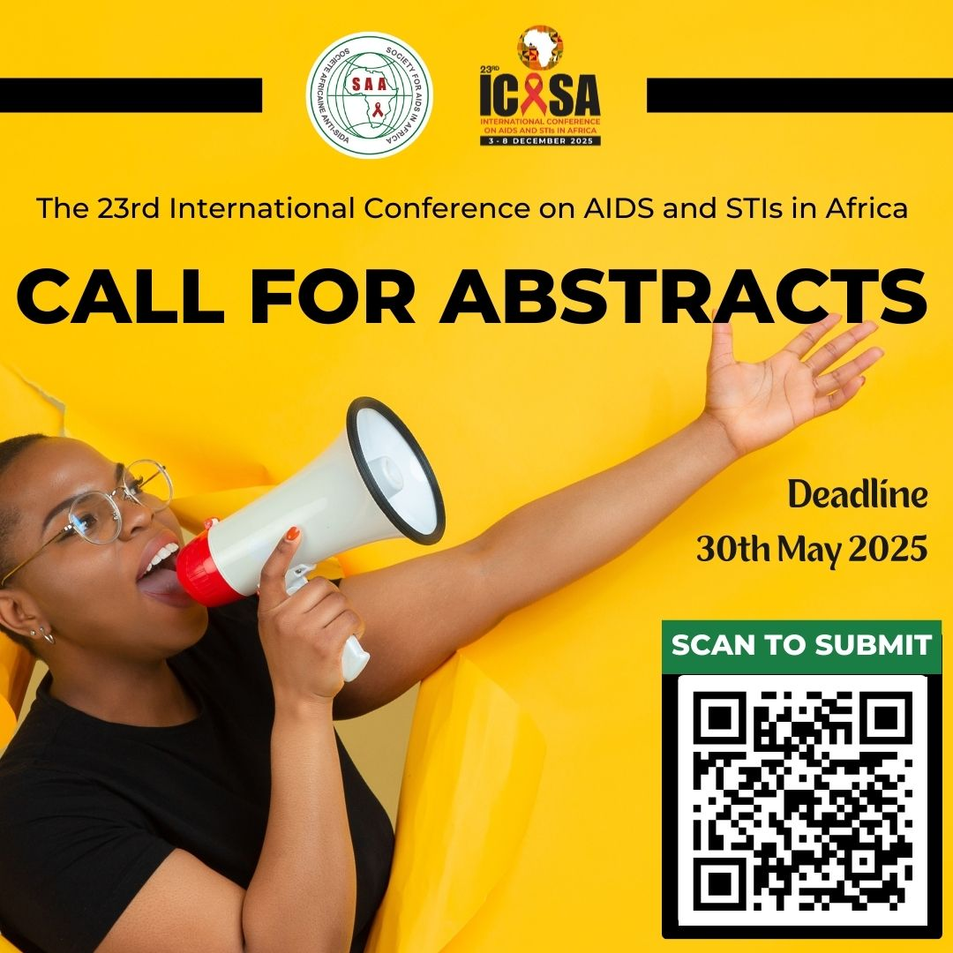

Slide 33
French Call and Abstract Training Session

Slide 34
Thank You for listening Questions
Contact: toyinukpong@yahoo.co.uk

